Slide 1
Sorting Algorithms
By Ethan Guttman
Date: 12/10/2023

Slide 2
What is a sorting algorithm?
Sorting is the process of rearranging the order of elements in a list such that they appear in ascending order
It may sound like a simple ordeal, but for real-world applications such as a computer needing to sort a database full of customer data, speed is of essence.
Due to this need for speed, there has been many attempts at creating a fast, efficient sorting algorithm for lists in various states of assortment.

Slide 3
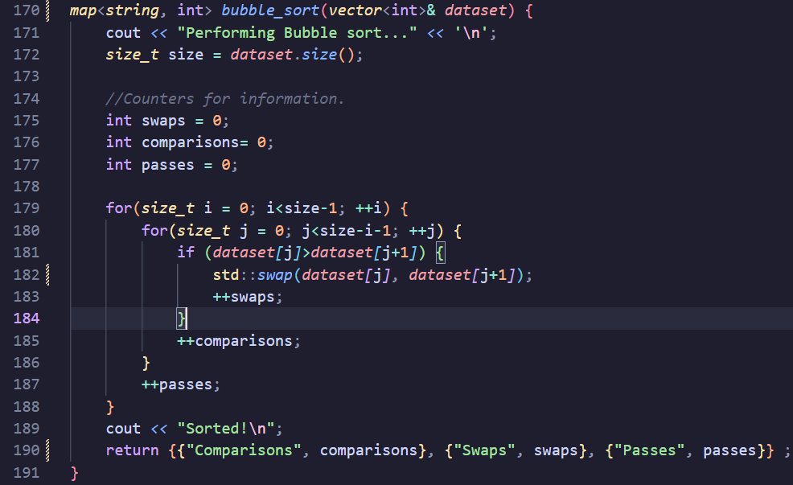
Bubble Sort
Bubble Sort is the one of the most primitive and simple sorting algorithms to exist.
Algorithm:
Start at the beginning of the list.
If the current element is greater than the next element, swap.
Move on to the next element.
Repeat a and b until you have reached the end of the list.
The item at the very end is sorted, so we only need to pass the next n - 1 elements next iteration
Repeat a - d until all elements have been sorted.
- All cases: O(n^2)
We can improve bubble sort…

Slide 5
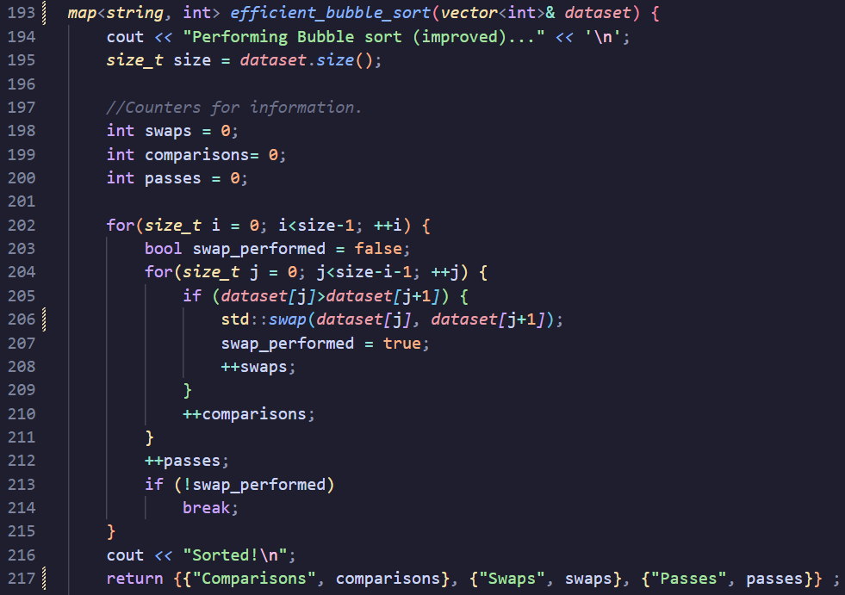
Improving Bubble Sort
Bubble sort currently needs to iterate n * (n-1), regardless of it sorted the list earlier.
So, we can add a boolean value called “swap_performed”
This will be set to true if bubble sort performs a swap.
However, if this value is never updated (the list is sorted before bubble sort iterates completely), we can terminate early.
Worst and Average: O(n^2)
Best: O(n)

Slide 6
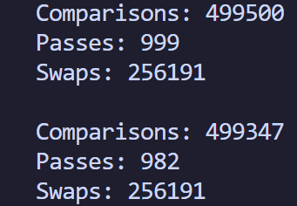
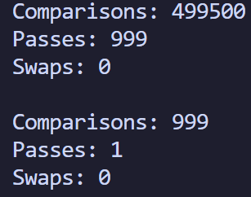
Comparing Normal Bubble vs Improved Bubble
Randomized Dataset. (1000 elements, from -1000 to 1000)
Best Case Scenario. (1000 elements, sorted)

Slide 7
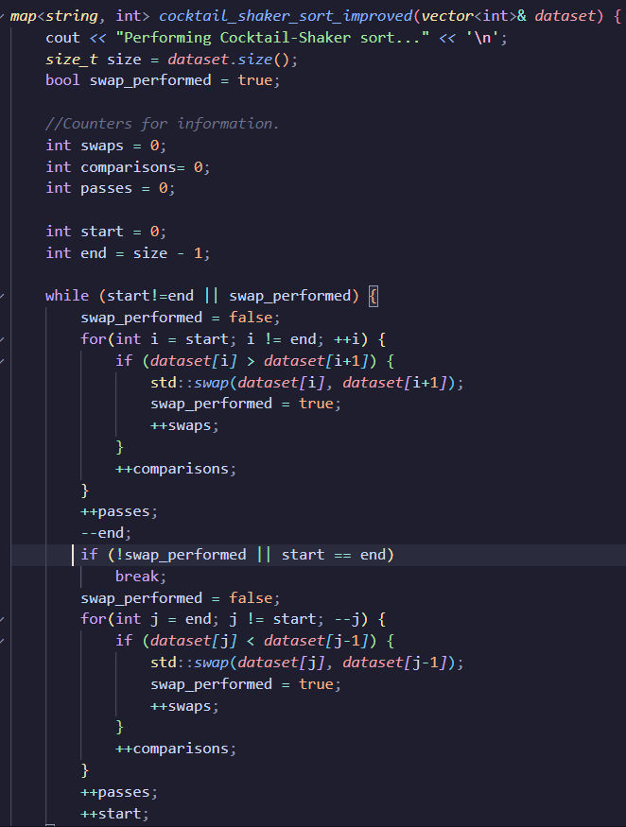
Cocktail-Shaker Sort
The cocktail shaker sort is a variant of bubble sort.
Instead of starting from the beginning of the list each pass, cocktail starts from where it ended last pass and reverses its direction, and compares if the element behind the current element is greater.
This sees some decrease in comparisons and swaps, as it moves items that belong towards the beginning of the list faster.
That is, when it has the boolean value tweak we added to the improved bubble sort.
Without that tweak, it performs the same as bubble sort. (As it continues to iterate through the sum of n-i elements (i being the # of passes) elements until n reaches 1).

Slide 9
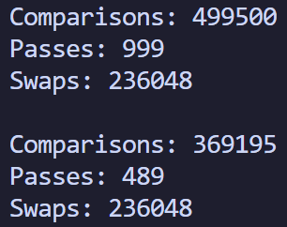
Comparing Improved Bubble vs Cocktail
Randomized Dataset (1000 elements, -1000 to 1000)

Slide 10
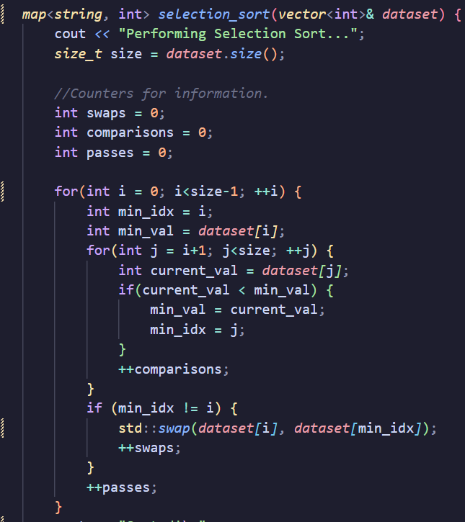
Selection Sort
Selection sort is another primitive sorting algorithm.
Algorithm:
Find the minimum of the the entire array.
Move the minimum to the front
Seperate the sorted part of the array from the rest that is not sorted.
Repeat steps 1-3 on the unsorted part until you are left with one element in the unsorted array.
All: O(n^2)
This may not seem impressive, but for computers that take a long time to swap elements, selection sort may be a choice, as it will only make (n-1) swaps.

Slide 12
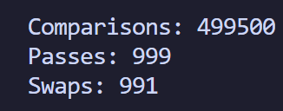
Selection Sort Performance
Randomized Array (1000 elements, ranged -1000 to 1000)

Slide 13
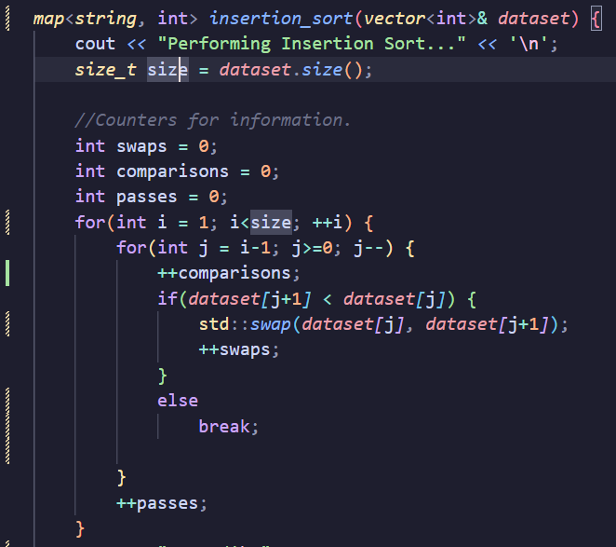
Insertion Sort
Insertion Sort is still a primitive sort, however, it performs notably better on average than the sorts mentioned prior.
Algorithm:
Start at the 2nd element of the list, i
Have another pointer point to the element in behind of i, j.
Compare the element in front of j.
If the element in front is greater, swap.
Otherwise, enter the skip to iteration (the element is inserted in the right area of the list)
Decrement j
Repeat c - d until the end of the list is reached.
Increment i
Repeat b - f until you are at the end of the list.
Worst and Average Case: O(n^2)

Slide 15
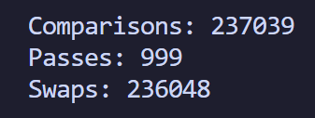
Insertion Sort Performance
Randomized Array (1000 elements, ranged -1000 to 1000)

Slide 16
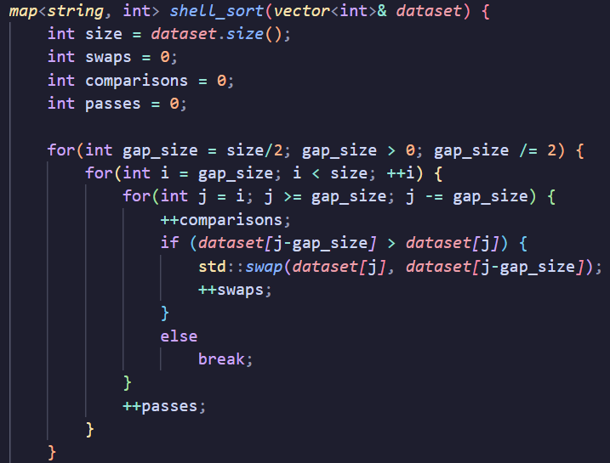
Shell Sort
Shell Sort is an extension of Insertion Sort that is significantly better.
It named after Donald Shell, who proposed in 1959 the idea of Shell Sort
It utilizes a gap size that groups elements into sublists which are then sorted by insertion sort.
This is useful, since after each subsequent pass, insertion sort works with a more sorted array each time as the gap size decreases, optimizing the algorithm.
Algorithm:
Initialize the gap size, which is normally n/2 when proposed by Shell.
Put all elements sharing that gap size into sublists.
Use insertion sort on each sublist.
Halve the gap size.
If gap size > 0, then repeat b-d.
All cases: O(n log(n))

Slide 18
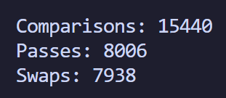
Insertion Sort vs Shell Sort Performance
Shell Sort
Insertion Sort

Slide 19
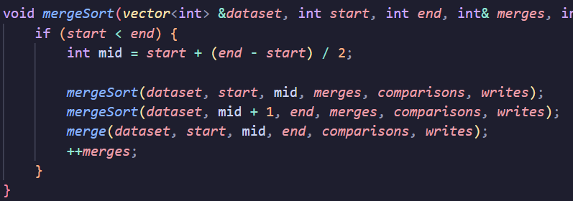
MergeSort
MergeSort is a divide and conquer algorithm that splits up the lists into 2 halved sublists until each sublist is a size of 1, then merges then back together, in the correct order.
Algorithm:
Find the middle index of the list
Split the list into two partitions, and perform MergeSort on each half (recursive)
Merge the two sorted halves.
Repeat until you have sorted the whole list.
This Algorithm may seem simple, but don’t let this fool you
All cases: O(n log(n))

Slide 20
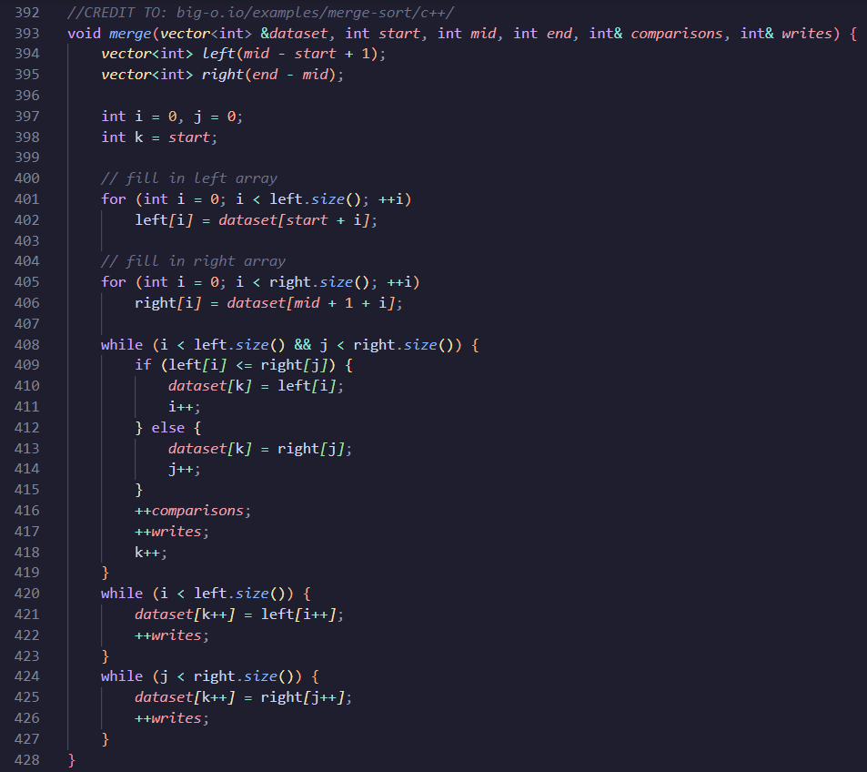
Merge SubRoutine
Algorithm:
Compare the first elements of the sorted left half list and sorted right half list. (the minimums of each list)
Write the minimum of the two values to the main dataset.
Repeat 1-2 until you reach the end of the left or the right.
Write the remaining elements of the left or right half (depending on which has elements left over) to the main dataset.

Slide 22
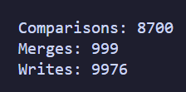
MergeSort Performance
Randomized Array (1000 elements, ranged -1000 to 1000)

Slide 23
Additional Considerations
In-Place vs Out of Place sorting
Merge Sort may be fast, but it needs to use at least O(n) auxiliary array space, since we store and sort our segments outside of the main array, and then overwrite.
All of the other sorts mentioned are in-place, or do not use auxiliary space.
If space is a constraint, merge sort may not be the best option, or you can use an inplace alternative to mergesort.

Slide 24
References
https://www.guru99.com/shell-sort-algorithm.html
(Gave me information on Shell sort).
https://big-o.io/algorithms/comparison/merge-sort/
(Gave me information on Merge Sort)
Rosen, Kenneth H. Discrete Mathematics and Its Applications. 8th ed., McGraw-Hill Education, 2019.
(The textbook we use)

